Slide 1
Group 6: assignment 1
IRADUKUNDA JEAN LOUS 25347
KAKWEZI PEACE 25437
AKIZE ISRAEL 25883
RUGAMBA MUVUNYI CHRIS 21891
ISHIMWE EMILE 26160
NSHIMIYIMANA THEOPHILE 25425

Slide 2
A. waterfall model
In software project management, the waterfall model is a linear and sequential approach where each phase of the project must be completed before the next phase begins.
Advantages:
Simple and Structured: The waterfall model is easy to understand and follow due to its clear stages and deliverables.
Predictable Timeline: With well-defined stages, it's easier to estimate project timelines and resource allocation.
Clear Documentation: The emphasis on documentation ensures a record of project decisions and facilitates communication.

Slide 3
Disadvantages:
Inflexible: Adapting to changing requirements or new information can be challenging due to the linear nature.
High Risk for Late Defects: Errors identified late in the process can be expensive and time-consuming to fix.
Limited User Input: User involvement is often limited to the initial stages, potentially leading to software that doesn't fully meet their needs.
Applications
Internal office application: Imagine a company needs a program to streamline expense reporting for employees. The requirements are clear: submit expense details, categorize them, and generate reports. User input might be limited to basic testing after development. Waterfall's structured approach ensures a well-defined product within budget and timeline constraints.

Slide 4
Standalone data processing tool: A scientific research lab might require a software program to analyze large datasets. The functionalities are well-defined, and user interaction is focused on data input and analysis results. Waterfall allows for a clear development roadmap and efficient coding based on established needs.
Embedded system firmware: Industrial equipment might require firmware updates to optimize performance. The functionalities are pre-determined, and user input isn't a major factor. Waterfall's emphasis on documentation ensures proper integration with existing systems and clear communication between development teams.

Slide 5
Simple mobile app with limited features: A restaurant chain might develop a basic mobile app for online ordering. The core features are set: browsing menus, placing orders, and payment processing. User feedback might be gathered after launch for future updates. Waterfall provides a structured approach for delivering a functional app within a defined timeframe.
Remember, these are just a few examples. The key takeaway is that Waterfall shines when requirements are clear, user input is limited, and the project has a well-defined scope.

Slide 6
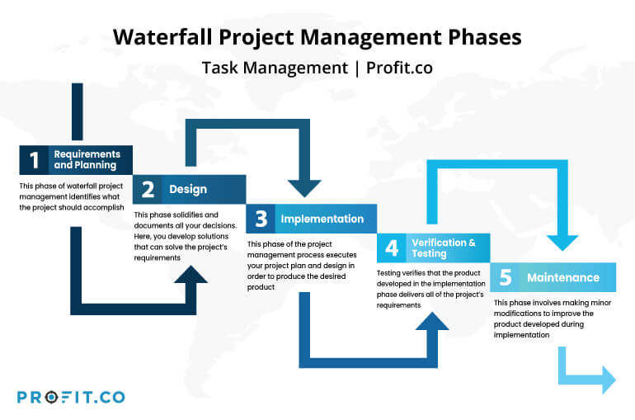

Slide 7
Prototyping
Prototyping in software project management is a method where you create an early version of a software program to test and refine its features .This early version is called a prototype
Or
Prototyping is a technique for creating a low-fidelity prototype of the software's user interface using photos or images

Slide 8
Advantages | Disadvantages
1. Provides a working model to the user early in the process, enabling early assessment and increasing user’s confidence. 2. The developer gains experience and insight by developing a prototype there by resulting in better implementation of requirements. 3. The prototyping model serves to clarify requirements, which are not clear, hence reducing ambiguity and improving communication between the developers and users. 4. There is a great involvement of users in software development. Hence, the requirements of the users are met to the greatest extent. 5. Helps in reducing risks associated with the software. | 1. If the user is not satisfied by the developed prototype, then a new prototype is developed. This process goes on until a perfect prototype is developed. Thus, this model is time consuming and expensive. 2. The developer loses focus of the real purpose of prototype and hence, may compromise with the quality of the software. For example, developers may use some inefficient algorithms or inappropriate programming languages while developing the prototype. 3. Prototyping can lead to false expectations. For example, a situation may be created where the user believes that the development of the system is finished when it is not. 4. The primary goal of prototyping is speedy development, thus, the system design can suffer as it is developed in series without considering integration of all other components.

Slide 9
Applications of prototyping
Prototyping isn't limited to just software development; it has applications across various fields where designing and testing an idea before full-scale execution is beneficial. Here are some examples:
Software Development:
User Interface (UI) and User Experience (UX) Design: Prototypes help visualize screen layouts, user flows, and interaction patterns. This allows for early feedback on usability and user experience before coding begins.
Testing Functionality: Low-fidelity prototypes can be used to test basic functionalities and identify potential flaws or areas for improvement.
Communication Tool: Prototypes act as a bridge between technical and non-technical stakeholders, facilitating clear communication about the software's vision and functionalities.

Slide 10
Product Design:
Physical Product Prototypes: Creating physical models or 3D-printed versions allows for testing form, fit, and user interaction with the product before mass production.
User Testing: Users can interact with prototypes to provide feedback on ergonomics, aesthetics, and overall product experience.
Refining Design: Prototypes help identify design flaws or areas for improvement before investing in manufacturing costs.
Web Design:
Website Layouts and Functionality: Prototypes allow for visualizing the website's structure, navigation, and content organization. This helps ensure a user-friendly and intuitive browsing experience.
Testing User Engagement: Prototypes can be used to test user interaction with website elements and identify areas that might lead to user frustration or confusion.
Client Feedback and Approval: Prototypes provide a clear visual representation for clients to review and provide feedback on the website's design and functionalities before development begins.

Slide 11
Marketing and Advertising:
Storyboarding and Concept Visualization: Prototypes, often in the form of sketches or mockups, can be used to visualize storyboards for commercials, presentations, or marketing campaigns.
Testing Effectiveness: Rough prototypes of marketing materials can be used to gauge user reactions and test the overall effectiveness of the message before a final campaign launch.
Iterating on Design: Prototypes allow for quick iterations and refinements of marketing materials based on initial feedback.

Slide 12
Beyond these examples, prototyping can be a valuable tool in various fields, including:
Architecture and Engineering: Prototyping physical models or digital simulations to test structural integrity, design feasibility, and user flow within a space.
Game Design: Creating playable prototypes to test game mechanics, balance, and user enjoyment before full game development.
Fashion Design: Prototyping garments or accessories with basic materials allows for testing fit, style, and overall design before investing in final materials and production.
Phases of prototyping

Slide 13
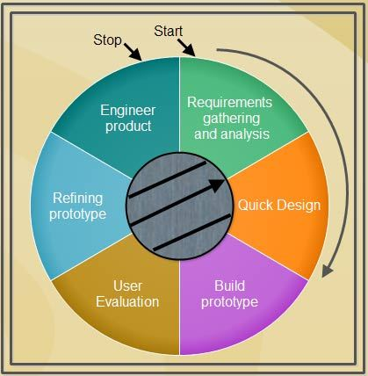

Slide 14
Requirements gathering and analysis: A prototyping model begins with requirements analysis and the requirements of the system are defined in detail. The user is interviewed in order to know the requirements of the system.
2. Quick design: When requirements are known, a preliminary design or quick design for the system is created. It is not a detailed design and includes only the important aspects of the system, which gives an idea of the system to the user. A quick design helps in developing the prototype.
3. Build prototype: Information gathered from quick design is modified to form the first prototype, which represents the working model of the required system.

Slide 15
4. User evaluation: Next, the proposed system is presented to the user for thorough evaluation of the prototype to recognize its strengths and weaknesses such as what is to be added or removed. Comments and suggestions are collected from the users and provided to the developer.
5. Refining prototype: Once the user evaluates the prototype and if he is not satisfied, the current prototype is refined according to the requirements. That is, a new prototype is developed with the additional information provided by the user. The new prototype is evaluated just like the previous prototype.
This process continues until all the requirements specified by the
user are met. Once the user is satisfied with the developed prototype, a final system is developed on the basis of the final prototype.

Slide 16
6. Engineer product: Once the requirements are completely met, the user accepts the final prototype. The final system is evaluated thoroughly followed by the routine maintenance on regular basis for preventing large-scale failures and minimizing downtime.
Differences
Waterfall vs. Prototyping in Software Development

Slide 17
Feature | Waterfall | Prototyping
Approach | Sequential, linear | Iterative, cyclical
Focus | Complete requirements gathering before development | Early user feedback and design exploration
Documentation | Highly emphasized, detailed documentation created upfront | Less emphasis, documentation evolves with iterations
User Involvement | Limited user involvement, primarily at the beginning | Early and continuous user involvement through feedback on prototypes
Flexibility | Inflexible, difficult to adapt to changes later in development | Flexible, allows for changes based on user feedback and evolving requirements
Risk of Errors | High risk of discovering defects late in development | Lower risk of errors due to early identification through user testing
Cost | Potentially lower initial cost due to less upfront planning | Can be slightly higher cost due to iterative nature
Development Development Time
 | Predictable development timeline, but can be lengthy | Less predictable timeline due to potential for changes based on prototypes
Suitable for | Projects with well-defined requirements and limited need for change | Projects with evolving requirements, need for user feedback, or uncertain design direction

Slide 18
END

